Slide 1
Lesson 304.2 -
Introduction to SQL Language

Slide 2
The SQL and MySQL
Learning Objectives:
By the end of this lesson, learners will be able to:
Describe the SQL language and MySQL.
Demonstrate how to install and configure MySQL.
Download and import data into MySQL.
Describe DQL, DML, DCL and TCL.
Utilize DQL, DML, DCL and TCL.

Slide 3
Table of Contents
3
Structured Query Language - SQL
MySQL
Database Schema Diagram
Data Query Language - DQL
SELECT Statement Syntax
Querying Everything
Retrieving Specific Rows
The distinct clause
SQL alias for Tables
Data Manipulation Language - DML
INSERT Statement
INSERT Statement - Bulk Records Inserts
Bulk Inserts From Another Table
UPDATE Statement
DELETE Statement
Deleting All Records
Atomicity
Transaction Control Language - TCL
start, rollback, and commit Statements
Data Control Language - DCL
CREATE USER Statement
GRANT Statement
Privilege Level in MySQL
REVOKE Statement
Data Integrity
Types of Integrity
Entity
Referential
Domain
User-Defined
Primary Key Constraints
UNIQUE Constraints
Foreign Key Constraints
Delete Actions

Slide 4
Structured Query Language
SQL (pronounced “ess-que-el”) stands for Structured Query Language.
SQL is used to communicate with a database. According to the American National Standards Institute (ANSI), SQL is the standard language for relational database management systems. SQL statements are used to perform tasks such as updating data on a database or retrieving data from a database.
While SQL is widely used in database systems, it's important to note that each system may have its own unique features, known as proprietary extensions. However, the core SQL commands, such as 'Select,' 'Insert,' 'Update,' 'Delete,' 'Create,' and 'Drop,' remain consistent across systems.
This cohort will use SQL using a MySQL database management system.

Slide 5
Structured Query Language (continued)
Structured Query Language (SQL) has five sub-languages:
DQL - Data Query Language.
DDL - Data Definition Language.
DML - Data Manipulation Language.
TCL - Transaction Control Language.
DCL - Data Control Language.

Slide 6
MySQL
The term, MySQL is simply the combination of “My” and “SQL”: MySQL.
MySQL is a database management system that allows you to manage relational databases. It is an open-source software backed by Oracle.
MySQL can run on various platforms such as UNIX, Linux, Windows, etc. You can install it on a server or even on a desktop. MySQL is reliable, scalable, and fast.
InnoDB became the default storage engine since the launch of MySQL 5.5.

Slide 7
Hands-On Lab - Installing MySQL
In this Lab, you will demonstrate installing the MySQL Workbench and a MySQL Server.
You can find the following labs on Canvas under the Assignment section.
GLAB - 304.2.1 - Installing MySQL Workbench on the Windows OS and MacOS
If you have any technical questions while performing the lab activity, ask your instructors for assistance.

Slide 8
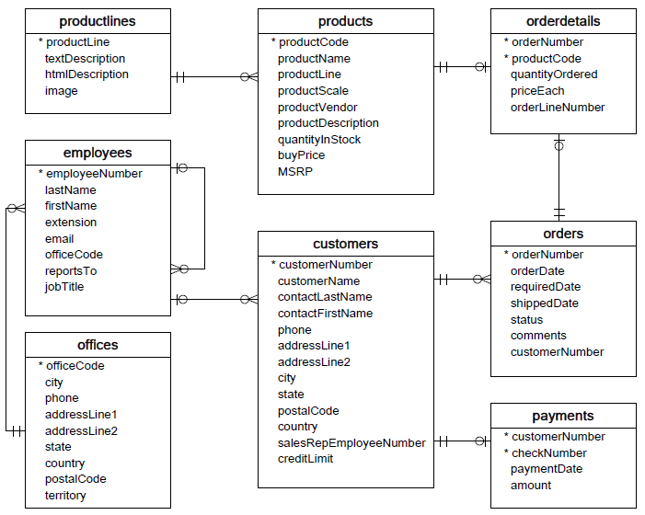
Database Schema Diagram
We will use the classicmodels database as an SQL sample database for the demonstration to help your work with SQL effectively. The classicmodels database is a retailer of scale models of classic cars. It contains typical business data such as customers, products, sales orders, and sales order line items, etc. See the schema diagram to the left.
You can find GLAB - 304.2.2 - Download “Classicmodels” Database Database on Canvas under the Assignment section.

Slide 9
Data Query Language
Data Query Language (DQL) statements are used to perform queries on data within schema objects. They allow for data to be retrieved from the database and orders to be imposed.
DQL includes the SELECT statement, which allows for getting the data out of the database and performing operations with it. When a SELECT statement is fired against a table or tables, the result is compiled into a further temporary table, displayed or perhaps received by the program (e.g., a front-end).

Slide 10
SELECT Statement Syntax
SELECT Statement with “DQL” clause ordering:
SELECT [ALL | DISTINCT | DISTINCTROW | Columns | Expressions ] clause specifies columns to retrieve.
FROM clause specifies table(s) from which to retrieve.
WHERE clause filters rows to retrieve.
GROUP BY clause specifies how to group results.
HAVING clause selects among groups.
ORDER BY clause specifies the row ordering.
The LIMIT clause specifies the limits of the retrieved records.
continue…

Slide 11
Example - Querying Data
Client Requirement: Janet, the VP of Marketing, has requested a list of all customer names and contacts, as well as their states, cities, and phone numbers for an outreach campaign. How can we help her?
Use the SELECT keyword to write a query.

Slide 12
Example - Querying Data
Syntax:
SELECT field1 [, field2, field3 …]
FROM tablename;
Example:
SELECT customerName, contactLastName, contactFirstName, city, state
FROM customers;
The selection of specific columns from a table is termed as a projection operation in relational algebra.

Slide 13
Querying Everything
Client Requirement: Janet realized that she needed more information. To minimize her demands on your time, she said, “give me everything about our customers.”

Slide 14
Example - SELECT *
Syntax:
SELECT *
FROM tablename;
Example
SELECT *
FROM customers;
This selection must be used with care. Selecting all data from tables with millions of rows is an exercise in frustration.
To retrieve just the number of rows from a table, we can use:
SELECT count(*)
FROM customers;
Queries that return a single value are scalar queries.

Slide 15
Retrieving Specific Rows
Client Requirement: Janet has decided to focus her campaign on customers in “Germany.” We can refine our query results using a WHERE clause:
SELECT *
FROM customers
WHERE country='Germany';
The selection of specific rows from a table is termed as a restriction operation in relational algebra.

Slide 16
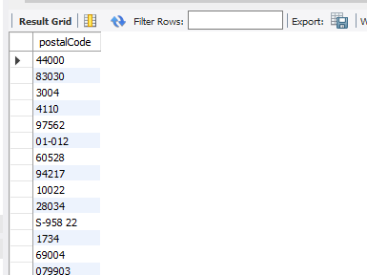
The distinct Clause
A select statement may return identical rows. To explicitly specify that you want to remove duplicate rows from the result set, use the distinct clause.
Syntax: select distinct column_name from table_name;
In the above syntax, the distinct keyword appears after the “select” keyword and before “columns or expressions” of the select list.
The query will return only distinct values from the “column_name” in the “table_name.”
Example:
SELECT distinct postalCode
FROM customers

Slide 17
SQL alias for Columns
Sometimes, column names are so technical that they make the query’s output difficult to understand. To give a column a descriptive name, use a column alias. The following statement illustrates how to use the column alias:
SELECT
[column_1 | expression] AS descriptive_name
FROM table_name ;
To assign an alias to a column, use the AS keyword, followed by the alias. But The AS keyword is optional so that you can omit it.
If the alias contains spaces, you must quote it as follows:
SELECT
[column_1 | expression] AS `descriptive name`
FROM
table_name;

Slide 18
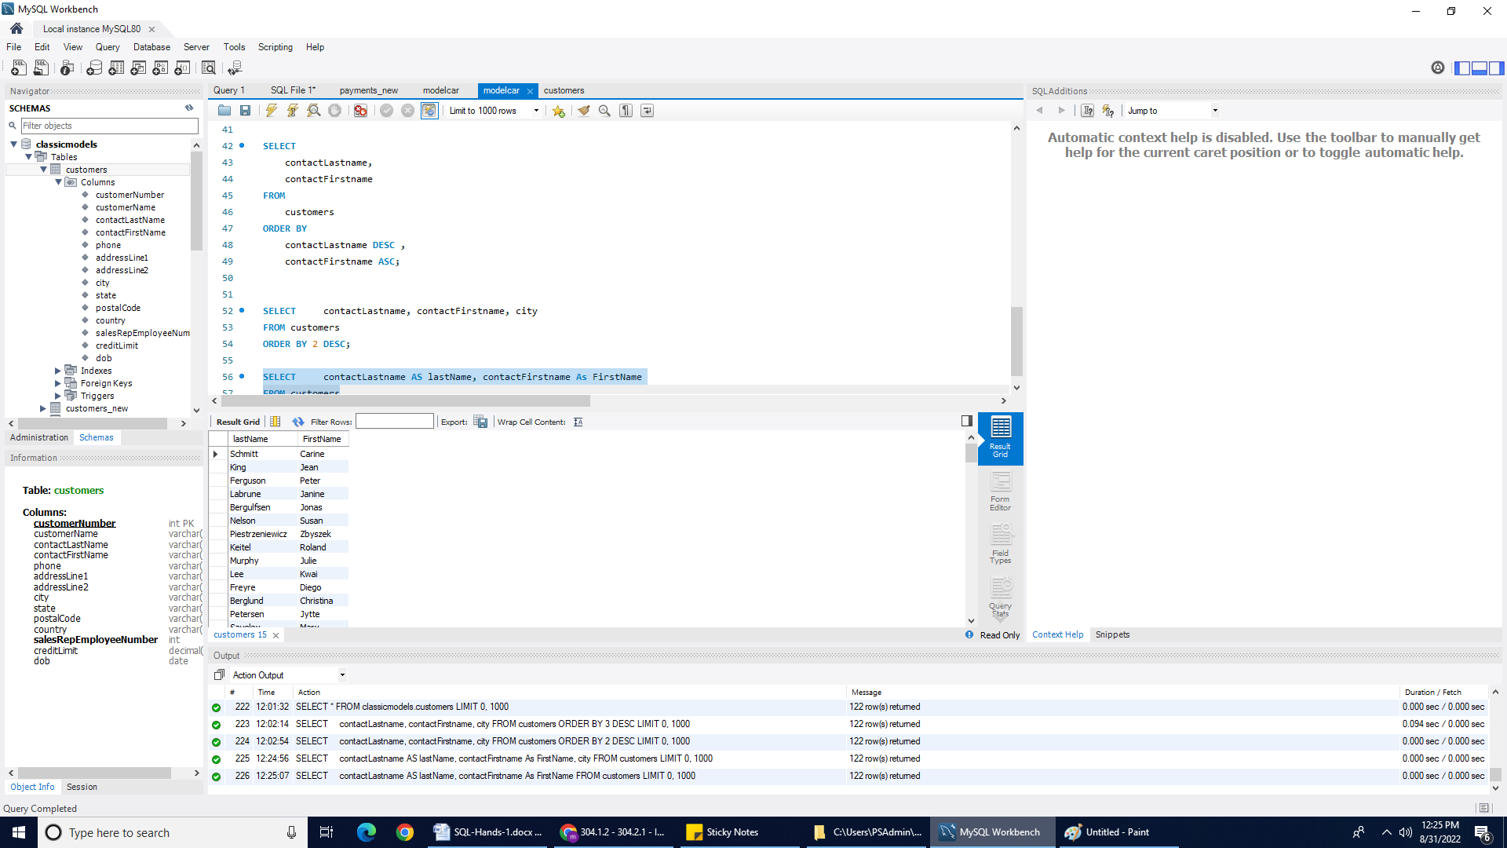
Example - SQL alias for Columns
SELECT
contactLastname AS lastName,
contactFirstname As FirstName
FROM customers;

Slide 19
SQL alias for Tables
You can assign a table an alias by using the AS keyword (optional) as the following syntax:
SELECT
[column_1 | expression]
FROM table_name AS table_alias
Example: The query below shows how to assign the employees table alias as e:
With AS keyword:
SELECT * FROM employees AS e;
Without AS keyword:
SELECT * FROM employees e;

Slide 20
Example: alias for Table
Once a table is assigned an alias, you can refer to the columns as shown below:
SELECT
e.firstName,
e.lastName
FROM
employees e
ORDER BY e.firstName;

Slide 21
Practice Assignment
Complete the Practice Assignment: PA - 304.2.1 - Practice Assignment - Select Statement Queries. You can find this assignment on Canvas under the Practice Assignment section.
Complete the following assignments by opening the links below.
Please take note that some questions may be difficult for you because they cover advanced topics; however, we will cover such advanced topics in later presentations.
SELECT_Basics
SELECT from WORLD
SELECT from Nobel
Note: Use your office hours to complete the assignments. If you have technical questions while performing the practice assignment, ask your instructors for assistance.

Slide 22
Data Manipulation Language
Data Manipulation Language (DML) allows you to modify the database instance by inserting, modifying, and deleting its data. DML is responsible for performing all types of data modification in a database.
Here are some important DML Statements in SQL:
INSERT.
UPDATE.
DELETE.

Slide 23
INSERT Statement
The INSERT statement is used to insert data into the row of a table.
Syntax:
INSERT [into] tablename [(col1, col2, …)]
VALUES ({expr | DEFAULT}, …);

Slide 24
Example: INSERT Statement
Client Requirement: Janet’s campaign was successful! Now you need to add new customers to the customers table.
Use the INSERT statement to add new row(s) to a table.

Slide 25
Example: INSERT Statement (continued)
INSERT into customers VALUES
(497, 'Jenny','Jenny','Jones','917-433-2828','12 Mockingbird Lane', NULL,'Omaha','NE','54550','USA',1056,2000.00);
The above statement inserts one row into the customers table.
Strings are enclosed in single quotes.
Numbers are given as literals.
Null provides a missing value.

Slide 26
INSERT Statement - Bulk Records Inserts
The INSERT statement can accept more than one set of values.
INSERT into payments (customerNumber, checkNumber, paymentDate, amount)
VALUES
(112, 'XL55793', '2017-12-13', 1258.16),
(128, 'QQ27862', '2017-12-13', 3426.26);
In the above example, we have included the field-list.
Note: Acceptable date formats are vendor-specific.

Slide 27
Bulk Inserts From Another Table
Bulk Inserts From Another Table
Inserts can be made from another table in the database (or a different database entirely) using INSERT… SELECT syntax:
Step 1: Quickly create a new table for demonstration by using the query below:
Step 2: The query below will copy data from the payment table into the temporary_payments table.
INSERT into payments (customerNumber, checkNumber, paymentDate, amount)
VALUES
(112, 'XL55793', '2017-12-13', 1258.16),
(128, 'QQ27862', '2017-12-13', 3426.26);
INSERT into temporary_payments
SELECT * from payments
WHERE amount>2000;
Note: If you do not understand the above query, do not worry about it. We will demonstrate this in upcoming lectures.

Slide 28
UPDATE Statement
Existing field(s) can be modified using the UPDATE statement.
Example:
UPDATE customers
SET phone='477-931-2258'
WHERE customerNumber=497;
UPDATE customers
SET addressLine1='27 Lands End', city='San Francisco'
WHERE customerNumber=212;
The WHERE clause is important in UPDATE statements. If omitted, fields of ALL rows will be updated with the given value(s).

Slide 29
DELETE Statement
It is occasionally necessary to permanently remove one or more rows from a table. If so, this can be done using the DELETE statement.
Example
DELETE
FROM employees
WHERE employeeNumber=1188;
The DELETE statement permanently deletes entire records matching criteria given in the WHERE clause.
Use carefully: If the WHERE clause is omitted, all rows will be deleted.
Notes:
Note: On production environment . We never delete any records. Mostly use Delete statement on development environment and testing environment

Slide 30
Deleting All Records
All records can be deleted from a table using either DELETE or TRUNCATE statement.
DELETE
FROM payments_high; -- deletes ALL rows.
TRUNCATE payments_high; -- deletes ALL rows.

Slide 31
Atomicity
Databases guarantee Atomicity:
When two or more DML statements execute, the database can ensure that all succeed or all fail.
When all statements “fail,” the database remains unchanged from its initial state.
This capability is provided using Transactions.

Slide 32
Transaction Control Language
Transaction Control Language (TCL) commands deal with the transactions within the database.
There are three main statements in a Transaction block.
START: Indicates the start point of an explicit or local Transaction.
COMMIT: Commits a Transaction.
Changes made within a Transaction are invisible to other users of the database until the COMMIT statement is issued.
ROLLBACK: Rolls back a Transaction in case of errors.
Databases guarantee Atomicity:
When two or more DML statements execute, the database can ensure that all succeed or all fail.
When all statements “fail,” the database remains unchanged from its initial state.
This capability is provided using Transactions.
Notes:
Transactions are initiated using a START TRANSACTION statement.

Slide 33
start, rollback, and commit Statements
Syntax:
rollback is usually executed within a procedure’s exception handler.
commit is issued after all statements successfully execute.
start transaction;
// [one or more DML statements]
rollback; or commit;

Slide 34
Example: rollback Statement
select count(*) from employees; -- returns 23 record
start transaction;
delete from employees where employeeNumber = 1143; -- one row deleted
select count(*) from employees; -- returns 22 record
rollback;
select count(*) from employees; -- return 23 record
All the changes will be reverted because of the rollback statement (rolling back a transaction). Other users of the database will not see the changes until you commit the Transaction.
Notes:
Notice that within the active transaction, we can see the database in the expected state.

Slide 35
Example: commit Statement
select count(*) from employees; -- returns 23 record
start transaction;
delete from employees where employeeNumber=1143; -- one row deleted
select count(*) from employees; -- returns 22 record
commit;
select count(*) from employees; -- return 22 record
This time, the commit statement saves all of the modifications made in the current transaction.

Slide 36
Data Control Language
Data Control Language (DCL) allows us to create users with more or less limited roles.
DCL mainly deals with the rights, permissions, and other controls of the database system.
DCL includes statements such as GRANT and REVOKE.
Users are added using create user.
Privileges are added using grant.
Privileges are removed using revoke.
Users are removed by drop user.

Slide 37
CREATE USER Statement
The CREATE USER statement creates one or more user accounts with no privileges. This means that the user can log into MySQL, but cannot do anything such as select a database or query data from tables.
Here is the basic syntax of the CREATE USER statement:
CREATE USER account_name
IDENTIFIED BY 'password';
In the above syntax, first, specify the account name after the CREATE USER statement, and then specify the password for the user after the IDENTIFIED BY keywords.

Slide 38
Example - Create New User
The query below will create a user named testUser, with a password.
The above query will create a user with NO privileges. This means that the user (testUser) can log into the MySQL, but cannot do anything. We have to grant the user privileges.
Create user testUser identified by 'Demopassword';
The query below query will show existing users from the current MySQL Server:
select user from mysql.user

Slide 39
GRANT Statement
Defines a user’s privileges.
To allow user accounts to work with database objects, you need to grant the user accounts privileges. The GRANT statement grants a user account one or more privileges.
The following illustrates the basic syntax of the GRANT statement.
GRANT privilege [,privilege],..
ON privilege_level
TO account_name;
In this syntax:
First, specify one or more privileges after the GRANT statement. If you grant multiple privileges, you need to separate privileges by commas.
Notes:
An object is a base table or view

Slide 40
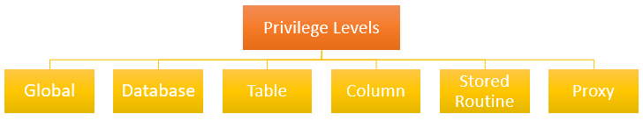
Privilege Level in MySQL
MySQL supports the following main privilege levels:
To assign global privileges, you can use the *.* For example:
To learn more about MySQL privileges, visit the Wiki document.
GRANT SELECT
ON *.*
TO abcUser;

Slide 41
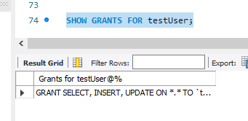
Example - Grant Statement
Grant select, update, insert
ON *.*
TO 'testUser';
The above query, Grant the account user 'testUser,' can query data from all tables in all database of the current MySQL Server.
SHOW Grants FOR testUser;
The above query will display the granted privileges of the 'testUser' user account:

Slide 42
REVOKE Statement
The REVOKE statement revokes one or more privileges from a user account. Basic syntax of the REVOKE statement that revokes one or more privileges from user accounts:
REVOKE
privilegee [,privilege]..
ON privilege_level
FROM user1 [, user2] ..;

Slide 43
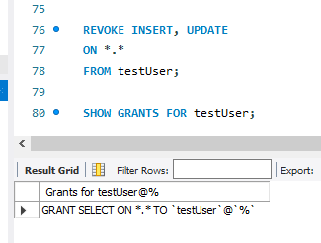
Examples - Revoke Statement
REVOKE INSERT, UPDATE
ON *.*
FROM testUser;
The above query will revoke the UPDATE and INSERT privileges from testUser account
SHOW GRANTS FOR testUser;
The above query will display the granted privileges of the 'testUser' user account. You will notice that UPDATE and INSERT privileges are revoked from testUser.

Slide 44
Knowledge Check
What is SQL? What is the full form of SQL?
What is MySQL?
What are the sublanguages of SQL?
What does DML stand for?
Can you INSERT data from one table into another table? If so, how?
The SQL statement that queries or reads data from a table is __________ .
USE
SELECT
READ
QUERY
What happens if you do not have a WHERE clause in an UPDATE statement?
What is DCL? Provide an explanation of some of the commands.
What is TCL? Provide an explanation of some of the commands.

Slide 45
Knowledge Check
Which SQL statement is used to return only different values?
SELECT DISTINCT
SELECT UNIQUE
SELECT DIFF
SELECT DIFFERENT
Which SQL statement is used to update data in a database?
MODIFY
ALTER
SAVE
UPDATE

Slide 46
Hackerrank Practice assignment
Find assignment PA - 304.2.2 - Practice Assignment - SQL on canvas under the Assignment section.
This assessment will be administered through HackerRank.
A Hackerank invitation will be required for this assignment. The instructor must coordinate with the curriculum team to create/set up an invitation link.
It is very important assignment, this assignment will prepare you for the SBAs and KBAs.

Slide 47
Summary
Structured Query Language (SQL) is a programming language designed to get information out of and into a relational database. Queries are constructed from a command language that lets you select, insert, update, and locate data. SQL is both an American National Standards Institute (ANSI) and an International Standards Organization (ISO) standard although many databases support SQL with proprietary extensions.
The SQL commands are mainly categorized as follows:
DDL – Data Definition Language.
DQl – Data Query Language.
DML – Data Manipulation Language.
DCL – Data Control Language.

Slide 48
References
https://www.youtube.com/watch?v=7S_tz1z_5bA
https://dev.mysql.com/doc/refman/8.0/en/programs.html
https://www.techonthenet.com/mysql/index.php

Slide 49

Questions?
49

